Slide 1
Using data mining to determine which area is most affected by Coronavirus(COVID-19)
Published Link:
https://www.tandfonline.com/doi/pdf/10.1080/00139157.1972.9933001

Slide 2
Presented By
HASAN, NAZMUL
ID:18-37377-1

Slide 3
Acid Rain
Definition
Acid rain is caused by a chemical reaction that begins when compounds like sulfur dioxide and nitrogen oxides are released into the air.

Slide 4
Causes Of Acid Rain
The principal cause of acid rain is from human source
Industrial factories, power-generating plants and vehicles
Sulfur dioxide and oxides of nitrogen are released during the fuel burning process .

Slide 5
Main Component Of Acid Rain
The main component of acid rain
Sulfur monoxide (SO)
Sulfur dioxide (SO₂)
Nitrogen oxides (NO_{X})

Slide 6
Sources of SO₂ and NO_{X}
Burning of fossil fuels to generate electricity. Two thirds of SO₂ and one fourth of NO_{X} in the atmosphere come from electric power generators.
Vehicles and heavy equipment.
Manufacturing, oil refineries and other industries.

Slide 7
Summary
Acid rain is a broad term that includes any form of precipitation with acidic components, such as sulfuric or nitric acid that fall to the ground from the atmosphere in wet or dry forms.
Here we will look at how acid rain is made and what harm acid rain does to people and the environment and how to solving of it.

Slide 8
Effects of Acid Rain
Acid rain can be extremely harmful to forests
Acid rain that seeps into the ground can dissolve nutrients, such as magnesium and calcium, that trees need to be healthy.
Acid rain also causes aluminum to be released into the soil, which makes it difficult for trees to take up water.

Slide 9
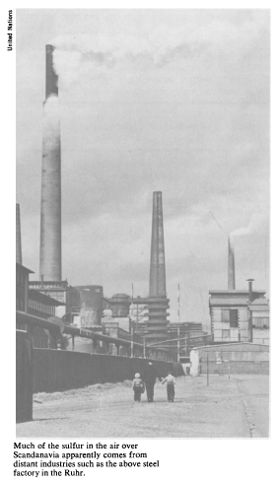
Produce sulfur by factory

Slide 10
Reducing the effects of Acid Rain
Turn off electrical equipment when it is not being used .
Try to limit the use of oil conditioning.
Powered limestone/limewater added to water and soil to neutralize acid.
Used extensively in Norway and Sweden
Expensive, short-term remedy.

Slide 11
Preventive Measures
Removes sulfur dioxide from flue gas.
Consists of a wet scrubber and reaction tower equipped with a fan that extracts hot smoky stack gases from a power plant into the tower.
Reduce amount of sulfur dioxide and oxides of nitrogen released into the atmosphere
Reduce cleaner fuels.

Slide 12
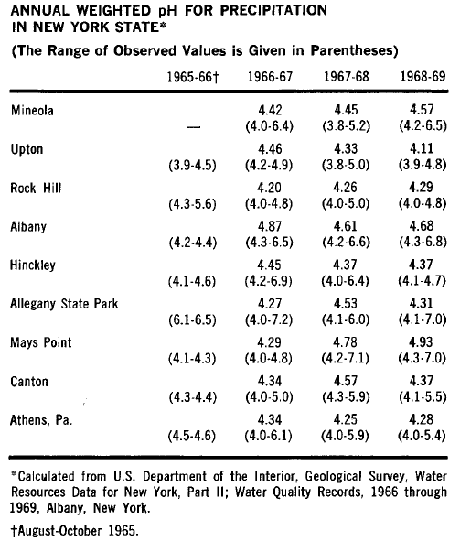
Analyzing PH result

Slide 13
Analyzing patterns & Pattern result
There are many PH value of water.
The annual pH, based upon samples collected during the twelve-month period 1970-1971.
Current measurements over the entire state indicate that rain and snow are surprisingly and consistently acid.
Although there has been no apparent trend, 1971 is the only year in which the pH was less than 4.1. The lowest pH value recorded at Hubbard Brook was a surprisingly acid 3.0.

Slide 14
Suggestion
Avoid the use of air conditioner altogether.
Avoid unnecessary idling.
Go CFC-free.
Use alternative fuels.
Use natural gas.
Buy energy-efficient appliances.

Slide 15
Conclusion
Acid rain is slowly destroying our planet. It is our responsibility to make sure that we protect the earth for future generations to enjoy.
Acid rain remains an acute problem in many parts of the world and is threatened by the rapid industrial development of the developing countries.

Slide 16
Thank you

